Slide 1
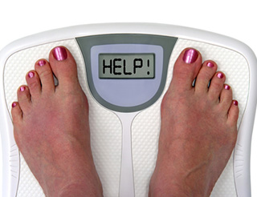
Proper Dieting Tips

Slide 2
Proper Dieting Tips
1. Eat a ______________ of food.
Answer: variety

Slide 3
Proper Dieting Tips
2. Eat _________, __________ and ___________ foods.
Answers: whole, fresh, unprocessed

Slide 4
Proper Dieting Tips
3. Eat plenty of _________, ___________ , and ________ _________.
Answers: fruits, vegetables, whole grains

Slide 5
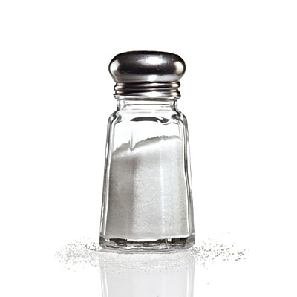
Proper Dieting Tips
4. Avoid too much ________, _____ ______, and ________.
Answers: sugar, trans fat, salt

Slide 6
Proper Dieting Tips
5. Drink plenty of ________ especially _______.
Answers: fluids, water

Slide 7
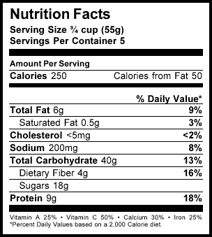
Proper Dieting Tips
6. Read _________ _________.
Answer: food labels

Slide 8
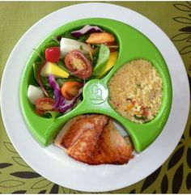
Proper Dieting Tips
7. Watch __________ sizes.
Answer: portion

Slide 9
Proper Dieting Tips
8. Eat something every___ hours.
Answer: 4

Slide 10
Proper Dieting Tips
9. Always eat____________.
Answer: breakfast

Slide 11
Proper Dieting Tips
10. ____________ every day.
Answer: Exercise

Slide 12
Proper Dieting Tips
11. Never consume less than _____ calories a day.
Answer: 1000

Slide 13
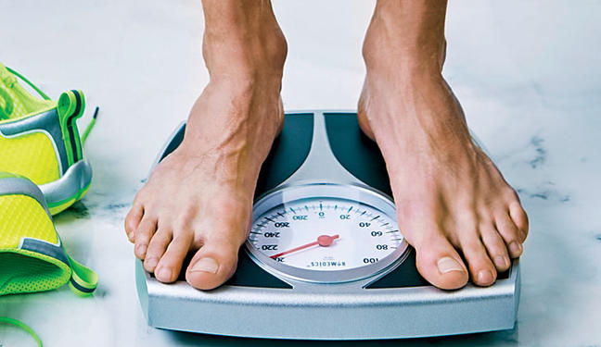
Proper Dieting Tips
12. Weight loss/gain should be ___ to ___ pounds per week.
Answer: 1, 2

Slide 14
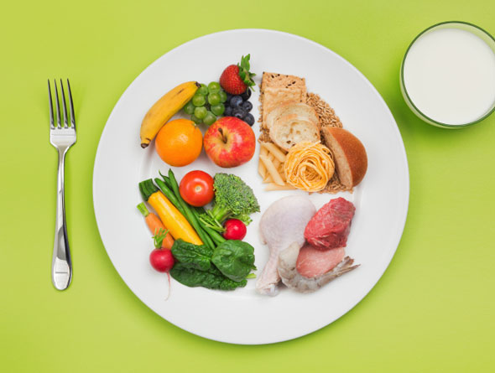
Proper Dieting Tips
13. Make a healthy ___________ change- a diet you can live with forever.
Answer: lifestyle

